Slide 1

A Socially Relevant Project -I presentation on Voice Enabled ATM
Presented by Batch No.: SRP-CSE-19-A-08
G. Naga Eshitha Roll No:19121A0565
C. Anusha Roll No:19121A0538
A. Abdul Bari Roll No:19121A0502
G. Hemanth Kumar Roll No:19121A0558
B. Nagendra Naik Roll No:19121A0524
Computer Science and Engineering
Under the guidance of
Dr.K.Reddy Madhavi
Associate Professor
Dept. of CSE
HOD:
Dr.B.Narendra Kumar Rao,
Professor & Head,
Dept. of CSE

Slide 2
Contents
Problem Statement
Abstract
Objectives
Introduction
System Requirements
Societal Applications
References

Slide 3
Problem Statement
Many people use ATM's inorder to make transactions but some illiterates doesn't know how to use the ATM and due to covid no one wants to touch the ATM screen. Even visually impaired can't use ATM's as they can't see the screen. By considering all the circumstances, voice assistant can be interlinked with ATM's kernel so that the visually impaired or others can independently make their transactions without others help.

Slide 4
Abstract
In this project, we are going to interconnect the voice assistant to one of the banking facility which is the ATM machine. First a person will enter into the ATM through door. The sensor which is attached to the door will detect the person and notifies the voice assistant. The voice assistant is set to the regional language by default, detecting its location. Now, the voice assistant will communicate with the person and asks his PIN number. It will recognize the PIN number said by the person from the microphone which is connected to the voice assistant. And later this voice is converted into text and text is given to ATM for checking purpose. ATM will sends the acknowledgement about the PIN as either its true or false. Based on the acknowledgement given by the ATM, voice assistant will act as per the given instructions. And if the PIN given is correct, it will ask the person to tell the amount that he need to draw. Either it will recognize the audio input or it will show the money on the screen for the confirmation purpose that needed to be drawn. After this confirmation, voice assistant will send the information to the ATM about money that he need to be drawn. ATM will provides the specified money and the person is told to take the money. Finally, it says "Thank you" for us. For this, the proposed solution is to use the ATM using voice assistant.

Slide 5
Objectives
To help the visually impaired by assisting them with the voice assistant.
To help the illiterates who can't understand the transaction process.
To help the society for performing transactions without touching the screen or keypad.
To make the ATM for processing fast transactions.
To reduce the usage of touch in ATM.
To make the voice assistant which helps in doing the transaction more secure.

Slide 6
Introduction
The proposed project can be considered as ATM and a voice assistant is connected to it. The voice assistant takes the speech as input and coverts to text. Default language is set to it based on the language preferred there. To make this more secure, we can use sensors and allow only one person or we can use OTP instead of ATM pin while using voice. A voice enabled ATM is a type of automated teller machine (ATM) that provides audible instructions so that persons who cannot read an ATM screen can independently use the machine. All audible information is delivered privately through a standard headphone jack on the face of the machine or a separately attached telephone handset. Information is delivered to the customer either through pre-recorded sound files or via text-to-speech speech synthesis.

Slide 7
System Requirements
OS-Android4.4.4.Android5.0-present
Processor-Core i3 processor or above
Storage-Between 40MB-80MB
RAM-Minimum 4gb,6-8gb is recommended
Screen-1200x800 pixels or higher
Software-Flutter and firebase, Android Studio, Eclipse
Permissions-Files, media, Location, Voice recorder
Browser/Internet-Application is designed to work online so it is recommended to have high speed internet connection.

Slide 8
Societal Applications
This app provides the basic model of voice enabled ATM, which can be used for assisting ATM transactions.
It also provides assistance to visually impaired to make transactions.
The voice assistant makes the transaction easier and helps to achieve less work-fast transaction.

Slide 9
DESIGN
Usecase Diagram
Class Diagram
Sequence Diagram
Activity Diagram

Slide 10
Use Case
Actors:
1.User
2.ATM
3.Database
Usecases:
1.Register
2.Login
3.Validating credentials
4.Withdraw
5.Transfer
6.Balance
7.Logout

Slide 11
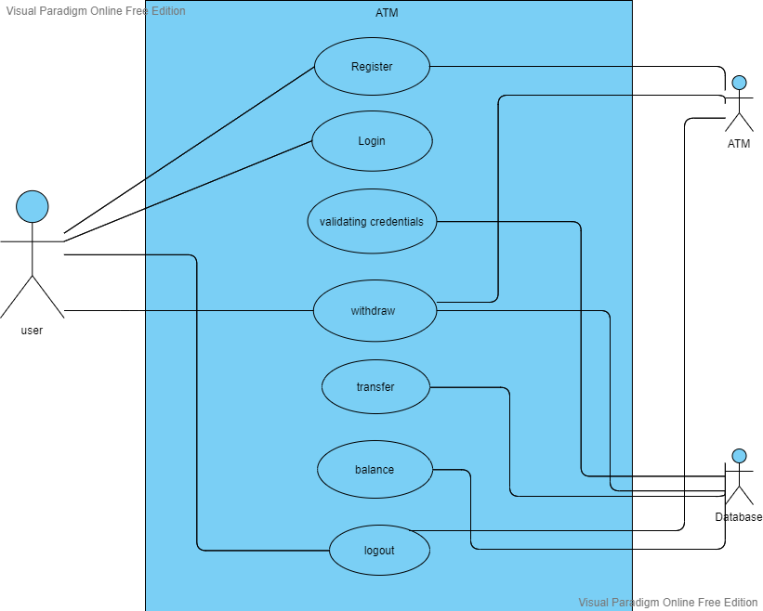
Use Case Diagram:

Slide 12
Class diagram
Class name | Attributes | Methods
ATM | Login, Register | Login(), Roothome()
Login | Email, Pin | Login(), Proceed()
Database | Validate, Update | Validate(), Update()
Registration | Firstname, Lastname, Email, Pin | Reg()
Transfer | Email, Amount | Mail(), Money()
Transaction | Withdraw, Transfer, Enquiry, Balance | Moneyout(), History(), Balance()

Slide 13
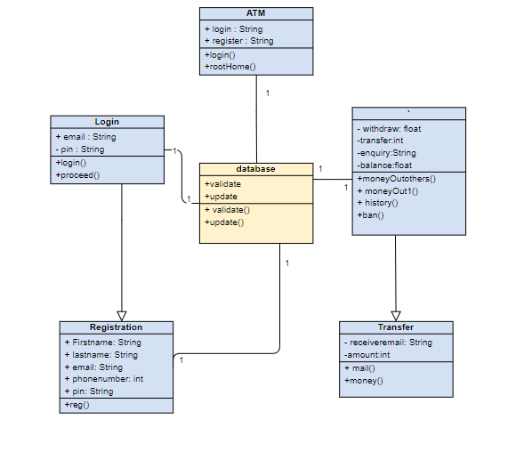
Class Diagram:
Transaction

Slide 14
Sequence diagram
Components:
Customer
ATM with voice
Database
Messages:
Welcomes customer and asks for login or register
Register details
Check credentials in database
If correct asks for the options to select
Performs action
Checks balance
Provides balance
Requests continuation
Terminate
Voice message saying thankyou

Slide 15
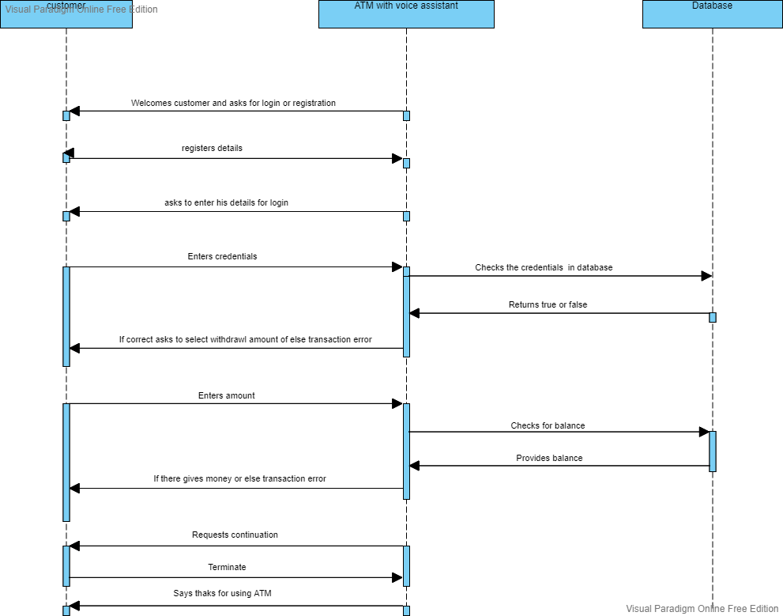
Sequence Diagram:

Slide 16
Activity Diagram
Components:
User
ATM
Database
Activities:
Enter login details
Check database
Validate
Options menu Select options
Fetch details
Update details
Perform transaction
Response and logout

Slide 17
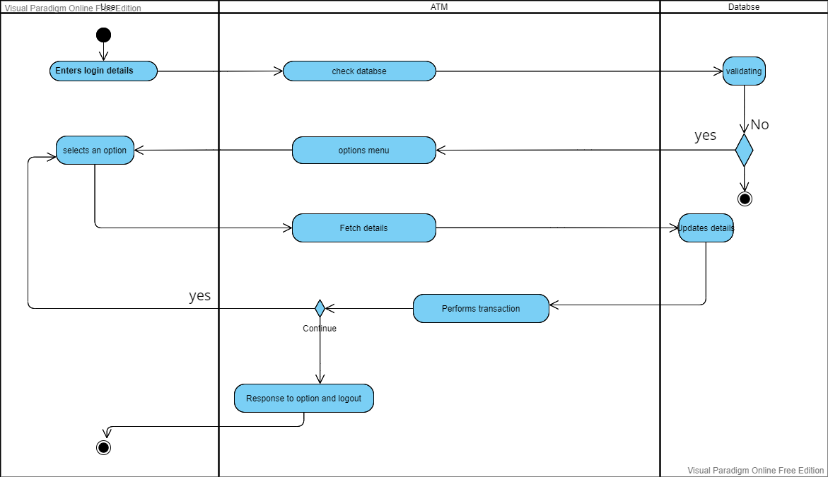
database
Check database

Slide 18
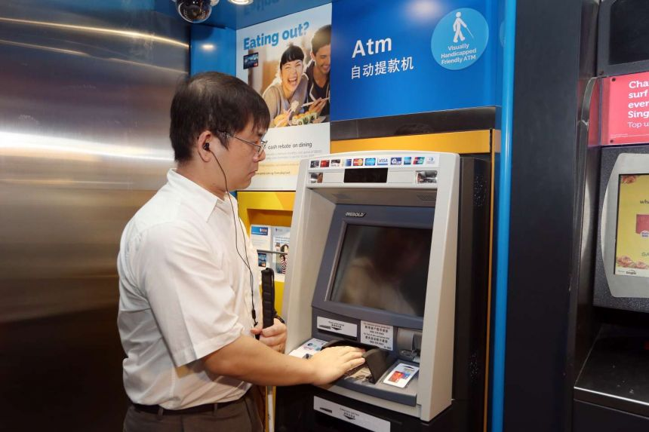
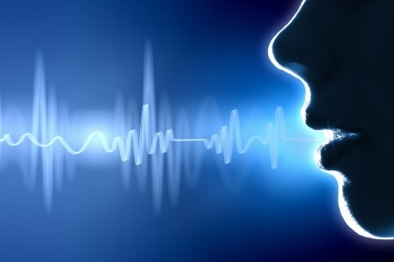
IMPLEMENTATION

Slide 19
Implementation of a voice enabled ATM is done by creating a model that works similarly as ATM.
This model is created using python with sqlite database for storing the data of the users or customers.
In this model, the voice input is taken by importing speech_recognition module in python and connection to the database is done by importing sqlite module and pyttsx3 module is also imported in order to process the speech to text.
A time limit is set in order to take speech input,if it can't recognize any speech, then it takes the text input and performs the user selected operation.
The user gets validated using E-mail and pin number in this model.
In the next slide, we can see the code importing the above modules.

Slide 20
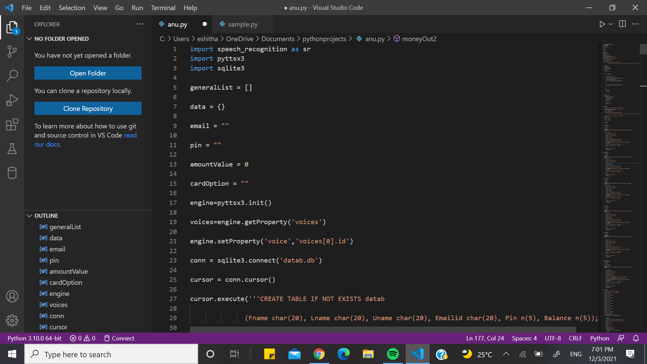

Slide 21
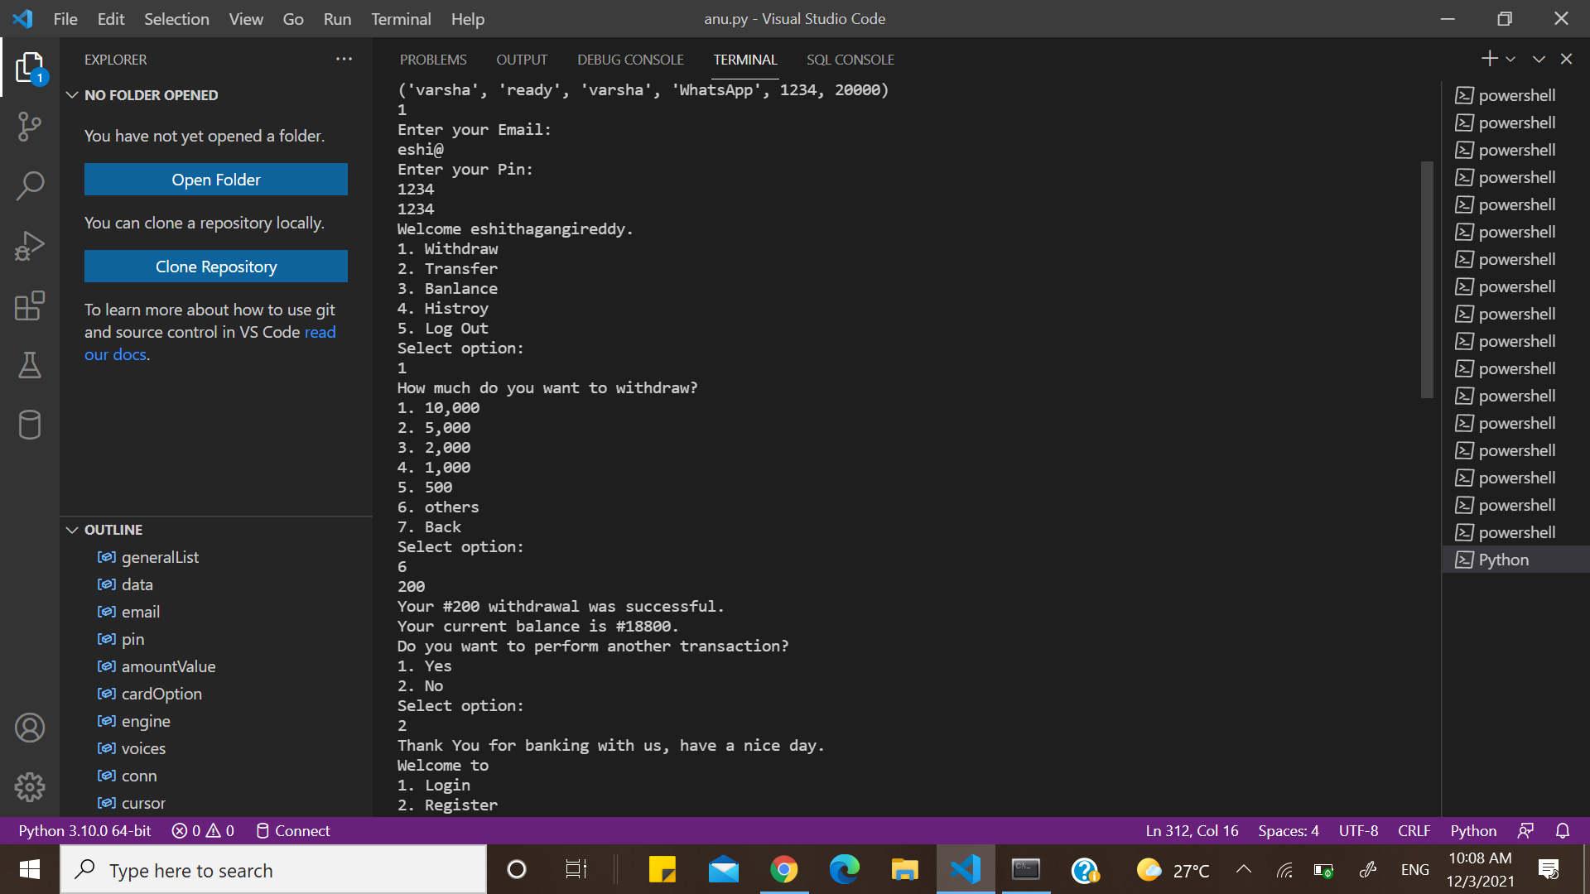

Slide 22
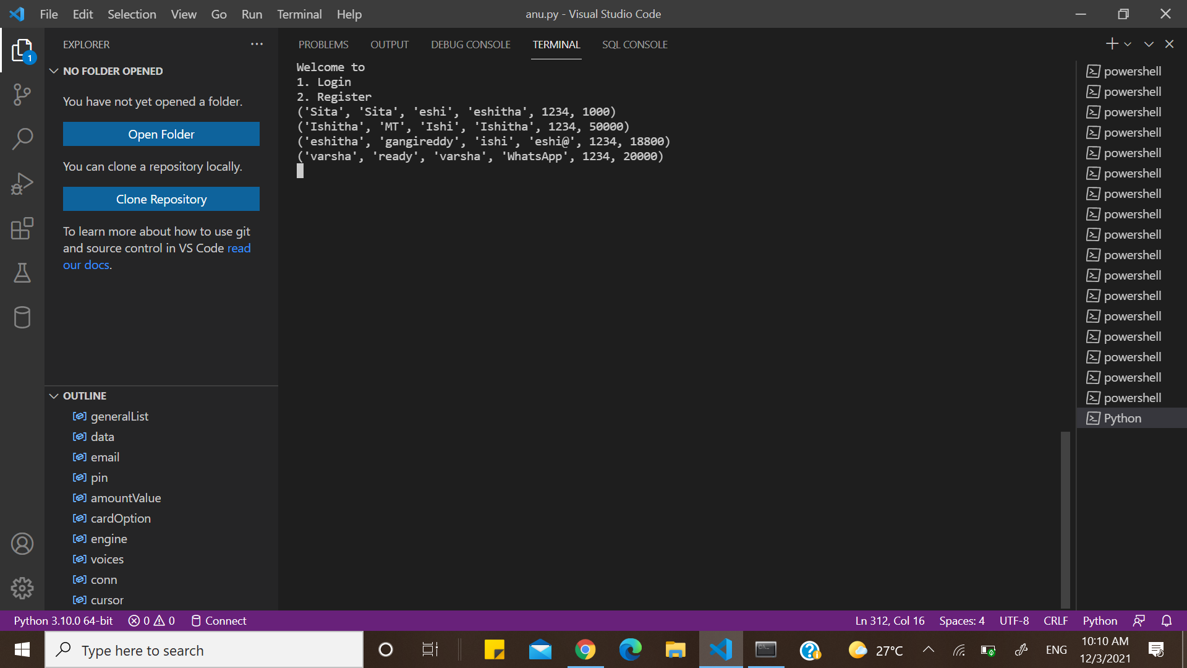

Slide 23
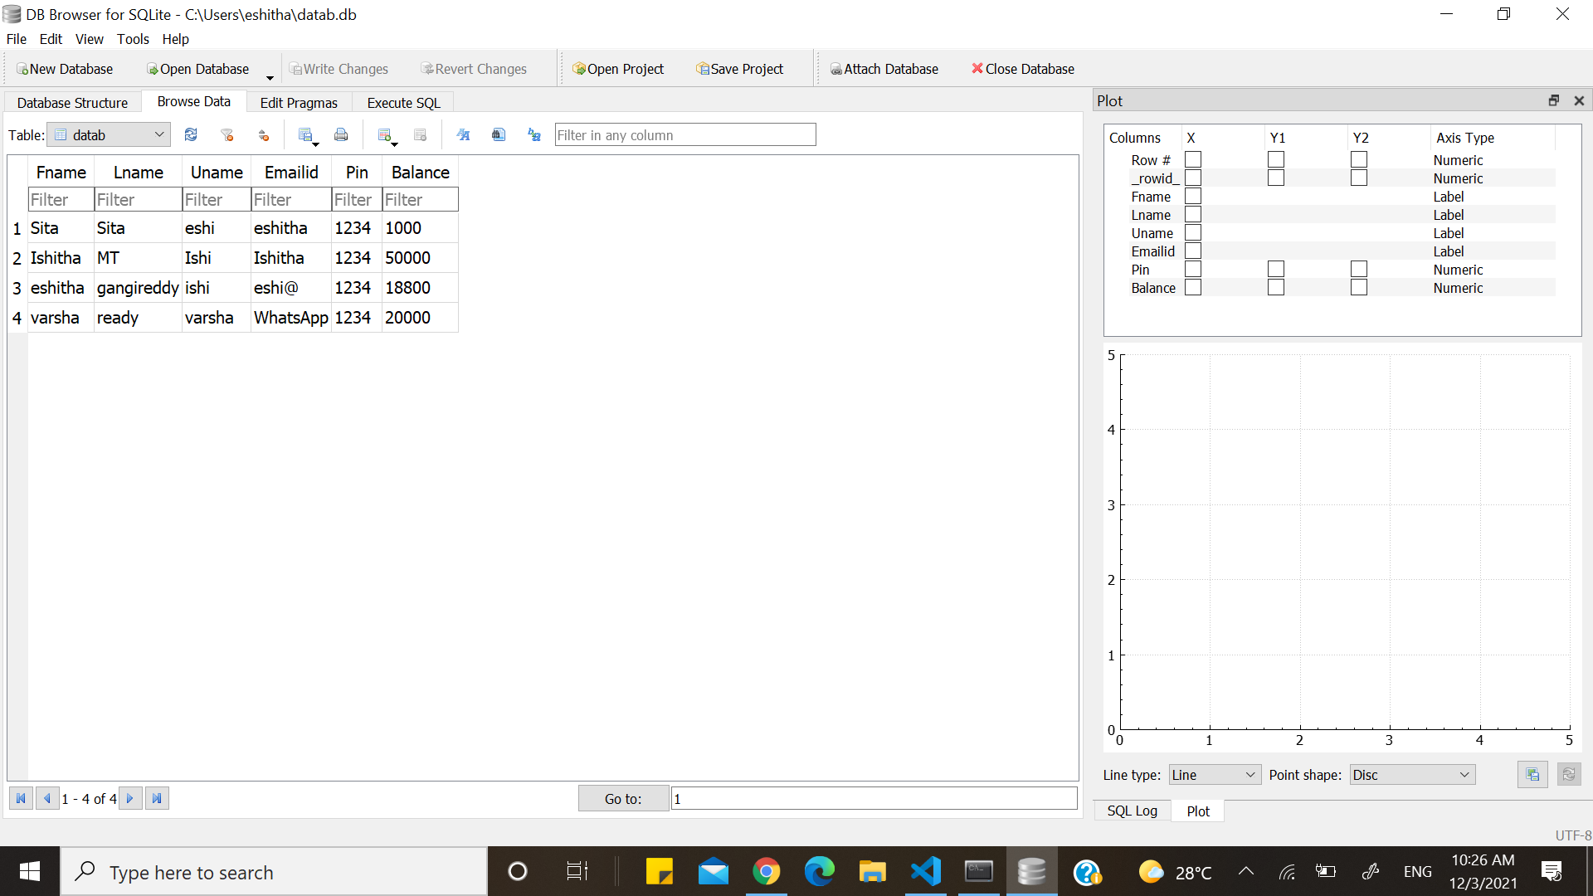

Slide 24
CONCLUSION
We have achieved the drawback of recognizing voice and assisting the users using voice. It is achieved using speech recognition module and pyttsx3 packages in python.
An ATM model is built using the python in Visual studio code which can perform all the functions performed by the ATM.
It takes both speech input or text input given by the user .
SQL database is used to store the data of the users in order to validate the login details of the user.

Slide 25
FUTURE WORK
In the future , It can be updated in order to take different languages.
It can be updated by implementing face recognition or iris or finger print in order to validate user credentials.
It can be updated to enter OTP instead of ATM pin in order to make it more secure.
Speech recognition can be improved in order to recognize the voice correctly and process it.

Slide 26
References
"Union Bank of India unveiled India's first 'Talking ATM'".
"Talking ATMs". www.unionbankofindia.co.in.
Talking ATM Wikipedia.
"State Bank of India launched its first ever 'Talking ATM' in New Delhi".
Make Money Talk. RNIB,2011

Slide 27
Queries

Slide 28
Thank You

